Slide 1
Introduction to Programming
Introduction to Programming
Data Types 1
Constants
Variables
Scanner Class
Lisa Murphy
Email: lisa.murphy@ncirl.ie

Slide 2
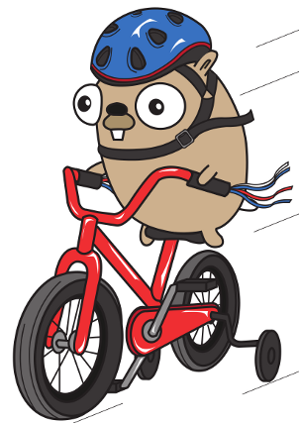
Introduction
Variables / Constants
Displaying Data
Calculations
Modulus
BOMDAS ()
Object Oriented Programming
Scanner Class (User Input)

Slide 3
Topic by Problem
1.
Each topic we do in class will represent a problem
2.
At the end of each lesson, you will solve the problem in your Lab class

Slide 4
Money Money Money
ChangeMoney is an app that calculates how much change you are owed given you price of what you are buying and how much money you hand over to the cashier. The app not only tells you how much you are owed, but breaks it down into currency denominations – 20s, 10s, 5s, 1s, 50c, 20c, etc
The class prompts the user to enter the price of item and the amount handed over.
The class should display the optimal number of 20s, 10s, etc that you should receive as change.

Slide 5

Process
Prompt to enter price
Prompt to enter amount
Calculate change
Determine currency denominations from change.
Display the result (true or false) in a message box.

Slide 6

What do we know already?
To construct a basic class
Use a main method
Output a literal string

Slide 7

What do we need to know?
To be able to successfully write the program we need to know the following:
Declare and Use Data types
Accept input from a user
Numerical calculations
Display variables

Slide 8

Data Types – 2 weeks
Over the next two weeks we will learn:
Data types
Variables & Constants
Real Numbers, Integers, Strings
Displaying Data
Keyboard Input
Numerical Calculations
Numeric Conversions

Slide 9
Numerical Calculations
We can combine variables using five simple arithmetic operations, you should all be familiar with the first four:
+ addition
- subtraction
* multiplication
/ division
However, you might be unfamiliar with the fifth one:
% modulus
The modulus A % B, returns the remainder when A is divided by B.
For example: 2 % 1 = 0 (i.e., 2 / 1 = 2 remainder 0)

Slide 10
Q uestions – Modulus
Find the answer for each of these
16 % 5
20 % 3
54 % 17
16 % 5 = 1
16 / 5 = 3 remainder 1
20 % 3 = 2
20 / 3 = 6 remainder 2
54 % 17 = 3
54 / 17 = 3 remainder 3

Slide 11
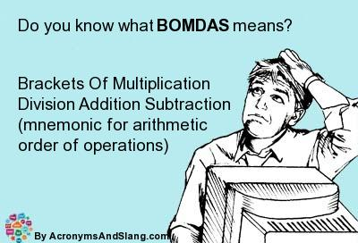
BOMDAS
Just like in maths – the same rules apply to Java!
Brackets - ()
Order – power, square, square root, etc
Multiplication
Division
Addition
Subtraction

Slide 12
BOMDAS Examples
What order would a Java program calculate the following:
3 + 1 / 3
= 4 / 3
3 * 3 + 4 / 2
= 9 + 2 = 11
2 * ( 1 + -(4/4) * 2 ) * (2 – 6/2)
= 2 * ( 1 + (-1) * 2) * (2 – 3)
= 2 * ( 1 + (-2)) * ( -1)
= 2 * (-1) * (-1)
= 2

Slide 13
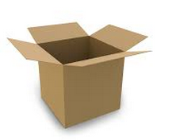
Variables / Constants
A variable is a named memory location that you can use to store a value.
A variable’s data-type describes the type of data that can be stored there: integers, real numbers, characters, etc
A data item is variable when its value can be changed while a program is running.
A data item is constant when its value can’t be changed while a program is running.
Today we will look at two data-types – one to store integers and one to store real numbers.
To use a variable we must first declare it.
The general syntax for declaring data-types is:
<data-type> <variable name>;
Notes:
Integers going to carry whole numbers: 1,2,3,4
Real

Slide 14
Declaring Integers
An integer is a whole number positive or negative.
General Format:
int is the data type we use to declare an integer.
<variable name> is the name given to the variable, it must start with a small letter, subsequent words start with a capital letter, no spaces.
As always all statements end with a semi-colon ( ; )
int <variable name> ;
int myAge;
int x, y;
int price;

Slide 15
Assigning Integers
We use the equals sign (=) to assign a value to the variable. This can be done in two ways:
int myAge = 25;
or
int myAge;
myAge = 25;
The statement ends with a semi-colon ( ; ) !!
myAge
25

Slide 16

Recap
//Declare a variable
int length;
Int breadth;
//Assign a variable
Length = 10;
Breadth = 20;

Slide 17
Declaring and Assigning Real Numbers
A real number is any number (both positive and negative) along the real number line.
In the same way as with integers we can declare a place in memory to store real numbers.
In general:
We use the data-type double to declare a real number.
As with the integer the <variable name> starts with a small letter, if multiple words are used – subsequent words start with a capital letters and all spaces are removed.
double <variable name>;
double rate;
double myWage;
double daysOfWeek;

Slide 18
Constants
Constants are a special kind of data-type.
They can not be changed during execution of the program.
Just as with variables we can have:
Integer constants
Real constants
In general:
Where <data-type> can be int or double (or any other valid data-type)
<constant-name> is the name given to the constant.
<constant-name> is written all in capital letters.
final <data-type> <constant name> = <value>;

Slide 19
Constants contd.
<value> is the value given to the constant and must be initialized at the time of declaration.
The value cannot be changed during the execution of the program.
For example:
final double PI = 3.14;
final int X=10;

Slide 20

Displaying Data
There are many ways to display data in Java. In our first lecture, we displayed a literal string.
A literal string – is printing the exact words that you want to be displayed as output. It is placed inside double quotes. For example:
System.out.println (“Print this string”);
1. System.out.print(<some output>);
This prints whatever is inside the round brackets
2. System.out.println (<output>);
This prints whatever is inside the round brackets and then prints a newline character
Both methods always ends with a semi-colon;

Slide 21
System.out.print / ln
These methods can be used in two ways:
To print a literal string as we have seen.
To print the value stored inside a variable as follows
When being used to print a value stored in a variable – we omit the double quotes.
int myNumber;
myNumber = 19;
System.out.print(“Print the value of my number”);
System.out.println(myNumber);

Slide 22
System.out.print / ln
We can combine the printing of a literal string and a variable in the same method using the + symbol. For example,
int myNumber;
myNumber = 19;
System.out.println(“Print the value of “ + myNumber);
+
(Add on Data)

Slide 23

E xercise 1 – Square.java
Let’s put it all together
Write a java program to calculate the area of a square, given the length of the side of the square is 10 units and display your answer. The file should be saved Square.java
Method:
Declare and initialize a variable to store the side of the square.
Declare a variable to store the answer.
Compute the area, given
area = length * length
Display your answer

Slide 24
E xercise 2 – Room.java
Write a java class that declares variables to represent length and width of a room.
Assign appropriate values to the variables.
Compute and display the floor space of the room (area = length * width) and perimeter of the room (perimeter = 2*(length+width).
Call this program Room.java

Slide 25
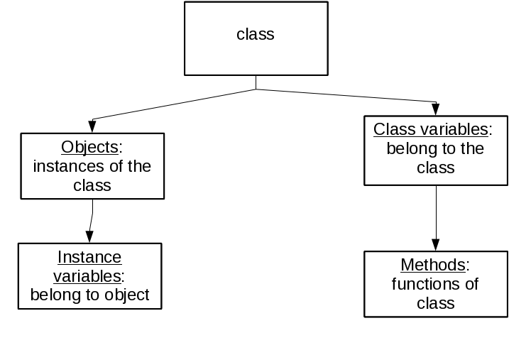
Concept of Object Oriented Programming
Think of our program as lots of different building blocks.
To perform a different task we need to use a different building.
Some of these building block are in-built in Java and some we write ourselves (this we will address in the coming weeks).
We can describe our program graphically using Object Diagrams.
To accept input from a User we use a building block that is in built into Java.

Slide 26
Accepting input from the User
There are many ways to accept data from a user. The first way we will look at is accepting data from the keyboard.
To display data we used System.out.print
To accept data we use System.in and the Scanner class.
If we think of the Scanner class as a special data-type – then to use it we need to declare and create a variable (called an object) so that we can use it. This is known as Object Oriented Programming.
We can describe our program graphically

Slide 27
Object Diagram
Room
main
keyboard
Scanner
nextDouble
nextInt

Slide 28
Declare and Create Object
To use an object we must declare and create it from its class.
<class name> is the name of the class of object we want to use, in this case Scanner is the the <class name>
<object name> is the name we give the object, think of it like a variable name, it starts with a small letter, any subsequent words start with a capital letter, there are no spaces.
<arguments> any variables, methods, objects that are passed in.
<class name> <object name>;
<object name> = new <class name>(<arguments>);

Slide 29

Scanner Class
For example,
Scanner is the <class name>
keyboard is the <object name>
System.in is <argument>
Scanner keyboard;
keyboard = new Scanner (System.in);

Slide 30
Scanner / System.in
The scanner class has many useful methods, now we will concentrate on the first two:
nextDouble()
Retrieves input as a double
nextInt()
Retrieves input an an integer
nexLine()
Retrieves the next line of data and returns it as a string
next()
Retrieves the next token and returns it as a string

Slide 31
Scanner class
Before we can use the Scanner class in a program, we must tell java where to find it. This is called an import statement and is written outside the class definition at the top of the program.
import java.util.Scanner;
In a program, when accepting input from the keyboard, we prompt the user for input using our display method (System.out.print/ln)
int days, weeks;
System.out.println (“Please enter a number of days >>”);
days = keyboard.nextInt ();
System.out.println (“Please enter a number of weeks >>”);
weeks = keyboard.nextInt ();
Declare variables
Ask the user for input
???????
Ask the user for input
???????

Slide 32
Putting it altogether
/*
* @author L Murphy
* @date: 09/07/2014
* @filename: Input.java
*/
import java.util.Scanner;
public class Input{
public static void main(String args[]){
//Accept users name and age from keyboard
int days, weeks;
Scanner keyboard;
keyboard = new Scanner (System.in);
System.out.println(“Enter days >>”);
days = keyboard.nextLine();
System.out.println(“Enter weeks >>”);
weeks = keyboard.nextInt();
System.out.println(“Number of days: ” + days);
System.out.println(“Number of weeks:“ + weeks);
}
}
Import the Scanner to allow user input

Slide 33
E xercise 3 – Room2.java
Modify Room.java to accept the length and width as an input from the user and rename it Room2.java

Slide 34

Other Exercises
AreaCircle | Find the area of a Circle Requires input from user Area = 3.14*(r*r)
AreaRectangle | Length, breadth, area Area = length * breadth

Slide 35

Extra Material
Numbers
Add the numbers 6 and 3
Numbers 2
Multiple the number 5.5 by 5.5
Make sure to create variables for the numbers and the sum of the numbers

Slide 36
Extra Material
AreaCircle.java
Find the area of a circle
Area=3.14*(r*r);
Accept input from the user – Please enter a radius
AreaRectangle.java
Develop an application that asks the user for the length and breadth and calculates the area of a rectangle
Hint: area = length x breadth

